Slide 1


KICKAAS
KICK AS A SERVICE
Johannes Bekele, Saniya Bhambhvani, Javier Esteban de Celis, Vamsi Garghi, Yuanfei He, and Shreya Rana

Slide 2

TABLE OF CONTENTS
Our Team
Testing
Our Project
Demo
Software Architecture
UI Design
Security Design
Database Design

Slide 3

OUR TEAM
OUR TEAM
OUR TEAM
OUR TEAM
OUR TEAM

Slide 4







OUR TEAM
Javier Esteban de Celis
Saniya Bhambhvani
Configuration Leader
Team Leader
Vamsi Garghi
Yuanfei He
Requirement Leader
QA Leader
Johannes Bekele
Shreya Rana
Design and Implementation Leader
Security Leader

Slide 5

OUR PROJECT
OUR PROJECT
OUR PROJECT
OUR PROJECT
OUR PROJECT

Slide 6

EVENT MANAGER

Slide 7




EVENT MANAGER
Event Manager is a lightweight, privacy-conscious application that allows users to create and manage various events. It will have many user-friendly features such as:
Event Creation and Management
Ticketing and Registration
Digital Ticket Delivery
Interactive Maps for Discovery

Slide 8

SOFTWARE ARCHITECTURE
SOFTWARE ARCHITECTURE
SOFTWARE ARCHITECTURE
SOFTWARE ARCHITECTURE
SOFTWARE ARCHITECTURE
SOFTWARE ARCHITECTURE
SOFTWARE ARCHITECTURE
SOFTWARE ARCHITECTURE
SOFTWARE ARCHITECTURE

Slide 9


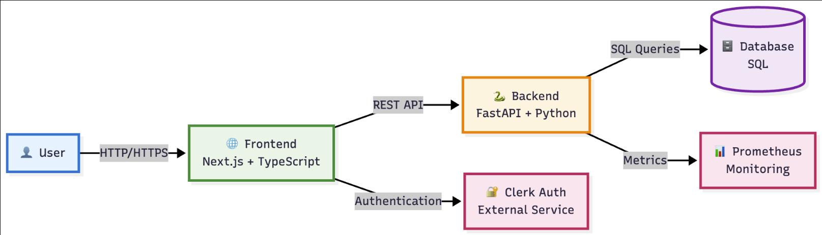
SOFTWARE ARCHITECTURE
Event Manager is a full-stack application that consists of separate software architectures for the frontend and backend. Both the frontend and backend consist of many different layers that aim to improve maintainability and scalability, and most importantly prevent any potential concerns/bugs.

Slide 10
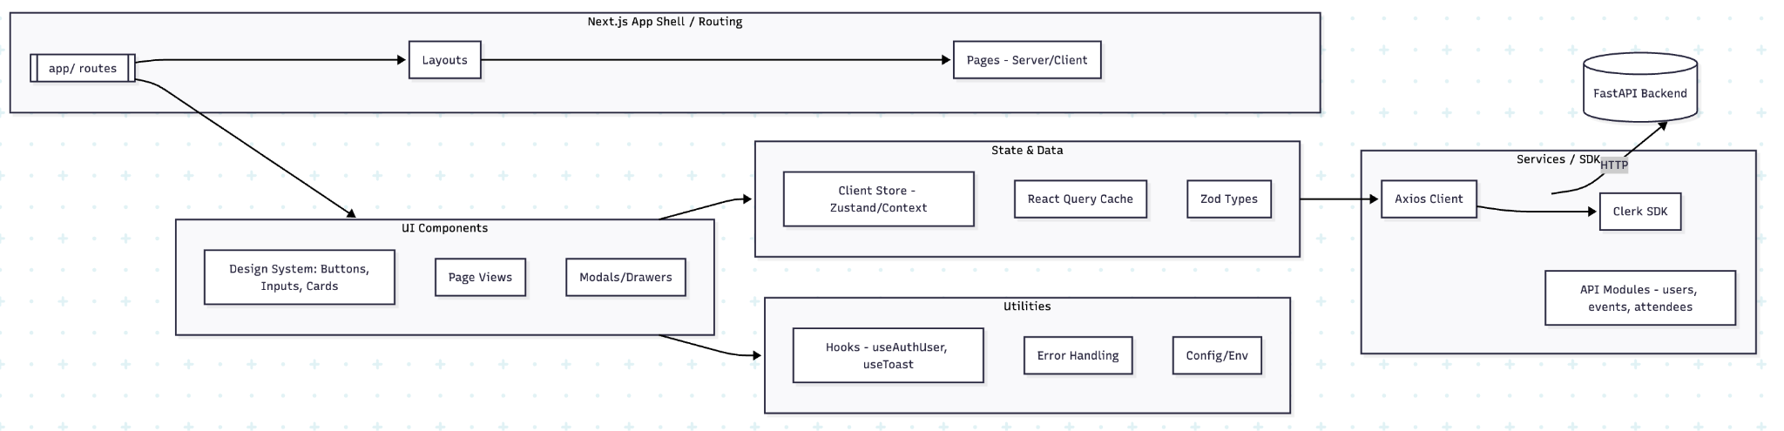
FRONTEND ARCHITECTURE
The frontend architecture has 5 layers including:
Next.js App Shell/Routing
UI Components
State and Data
Services/Software Development Kits (SDKs)
Utilities
Notes:
Router (App Shell) Layer
The Routes layer defines navigation, layouts and server vs. client component boundaries using the Next.js App router.
Layouts (app/(public)/layout.tsx), app/(protected)/layout.tsx) encapsulate headers, nav, and global providers (e.g. QueryClientProvider, ClerkPRovider, Toaster)
Routing splits public cs protected areas: Home, Docs, Sign-in/Sing-up, Discover (public) vs Events, Profile (protected)
Use server components by default for data-fetching pages that can be rendered on the server, and Client Components where interactivity/state is required (forms, modals, etc)
Page Guards use Clerk middleware and server helpers to redirect unauthenticated users.
UI Components Layer
The UI layer houses all visual building blocks
Design System primitives
Button, input, select, Modal, Card, Skeleton
Generated using headless/ui
Composites
NavBar, sidebar, EventCard, Attendee List, pagination
Patterns
Empty states, loading states, Error boundaries
Accessability
Semantic HTML, ARIA attributes
Styling
Tailwind CSS with a theme token file for colors/spacing
State and Data Layer
The layer centralizes client-side state management and data validation
React Query
For server data fetching, caching, retries, etc
Context for UI state (drawer open, wizard step) that should not live in URL or React Query
Zod
Schemas for runtime validation of API responses and forms
URL state
For shareable filters/sorts via search params; uses SearchParams
Services (API/SDK) Layer
All backend interaction and third-party SDK calls live here
Axios instance with baseURL from NEXT_PUBLIC_BACKEND_URL, JSON interceptors and Clerk token
API modules that expose type functions
services/user.ts
services/events.ts
services/attendeed.ts
Error normalization
Map HTTP errors to a consistent shape for UI consumption
Retries & timeouts: sensible defaults for HTTP requests and REact Query
Utilities Layer
Helpers and hooks that do not fit elsewhere
Auth helpers for client/server tokens
Formatter
Dates, currency
Error & Toast hooks
sonner

Slide 11

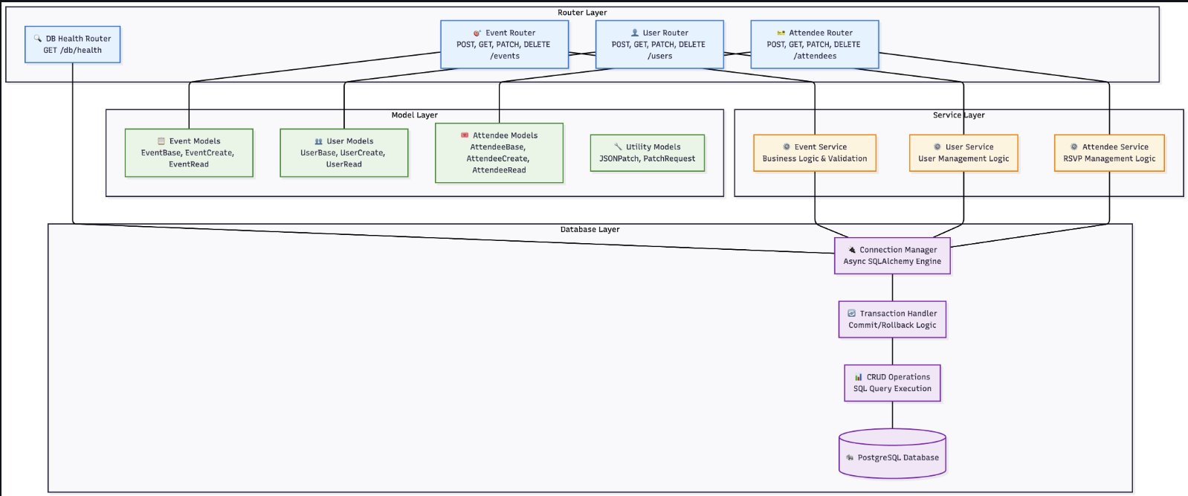
BACKEND ARCHITECTURE
The backend architecture has 4 layers including:
Router
Model
Service
Database

Slide 12
UI DESIGN
UI DESIGN
UI DESIGN
UI DESIGN
UI DESIGN

Slide 13
UI DESIGN
Event Manager uses a Next.js 15 framework along with Tailwind CSS v4 features.
Pages:
Landing
Create Event
Events
Discover
Styles:
Fonts
Geist
Sans
Mono
Sanchez
Icons
React Font Awesome 6 (fa6)
Theme
Light/Dark Mode
Native Colors
Amber/Indigo

Slide 14
DATABASE DESIGN
DATABASE DESIGN
DATABASE DESIGN
DATABASE DESIGN
DATABASE DESIGN
DATABASE DESIGN
DATABASE DESIGN
DATABASE DESIGN
DATABASE DESIGN

Slide 15

DATABASE DESIGN
Event Manager is using a PostgreSQL database because it prioritizes data integrity, scalability, and efficient query performance. Our database was designed to support all of the Event Manager’s essential functionalities such as user management, event creation, categorization, and attendee registration which resulted in 4 tables:
Users
Events
EventAttendees
Categories

Slide 16
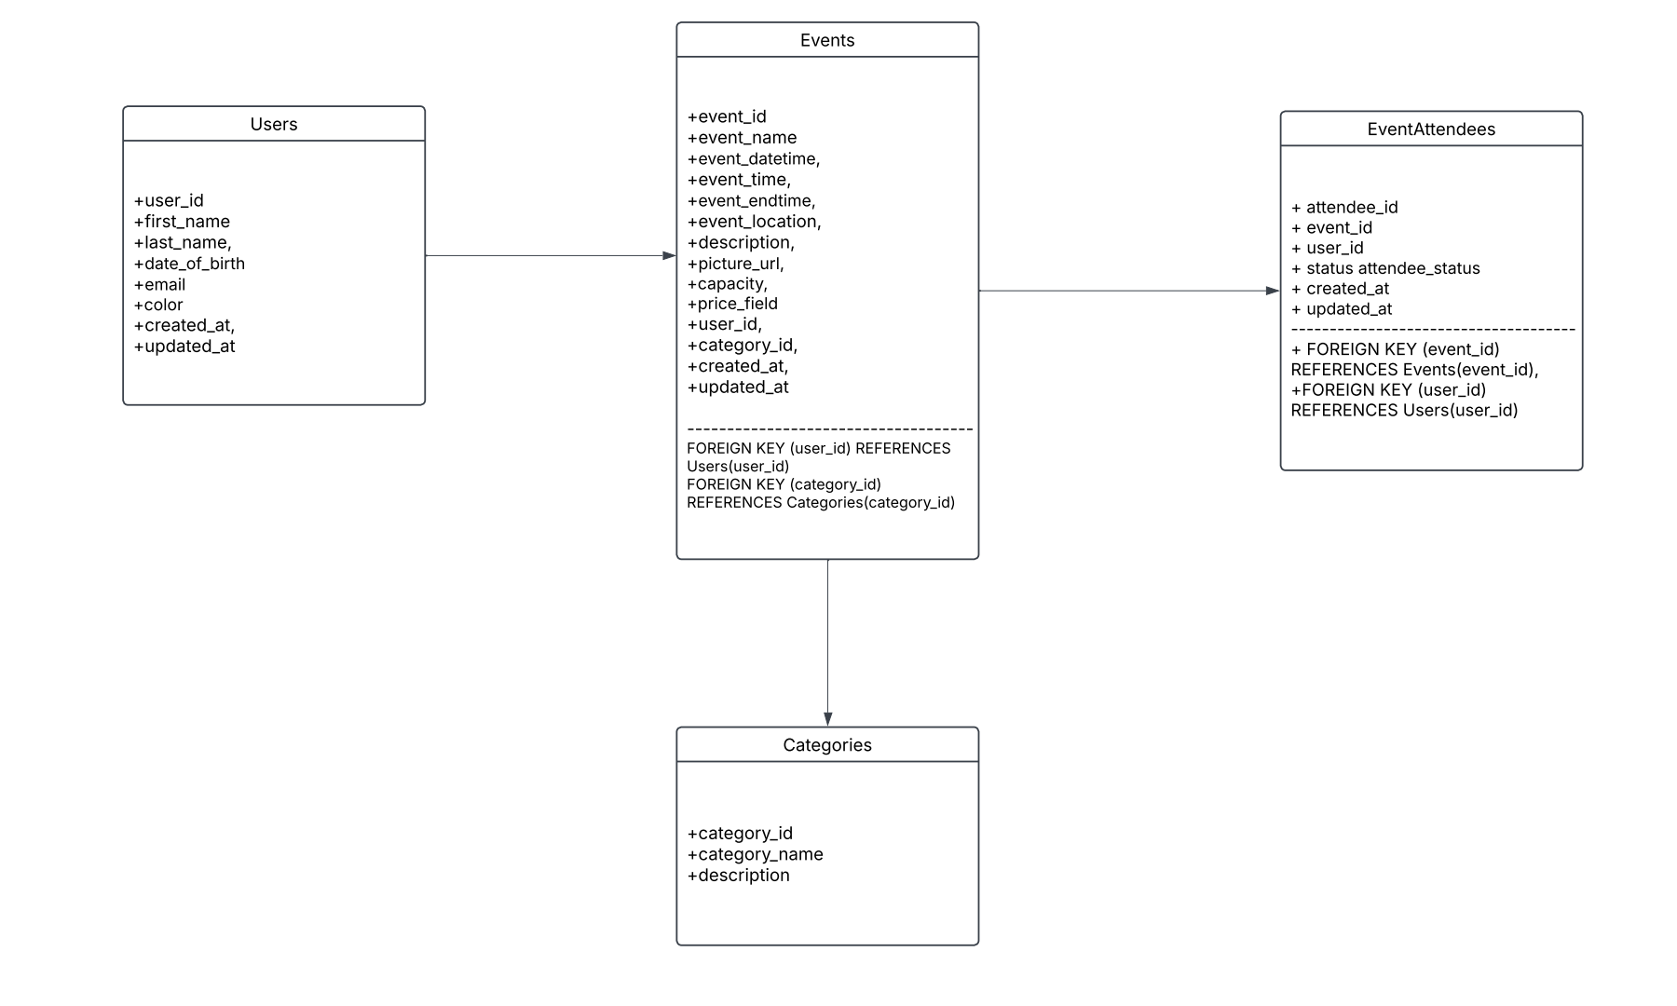

Slide 17
SECURITY DESIGN
SECURITY DESIGN
SECURITY DESIGN
SECURITY DESIGN
SECURITY DESIGN
SECURITY DESIGN

Slide 18

SECURITY DESIGN
Event Manager wants to ensure security across all layers of our application through authorization, data protection, and input validation using these tools:
Clerk
FastAPI/Pydantic
Semgrep
Hadolint
Pip-Audit
Gitleaks

Slide 19
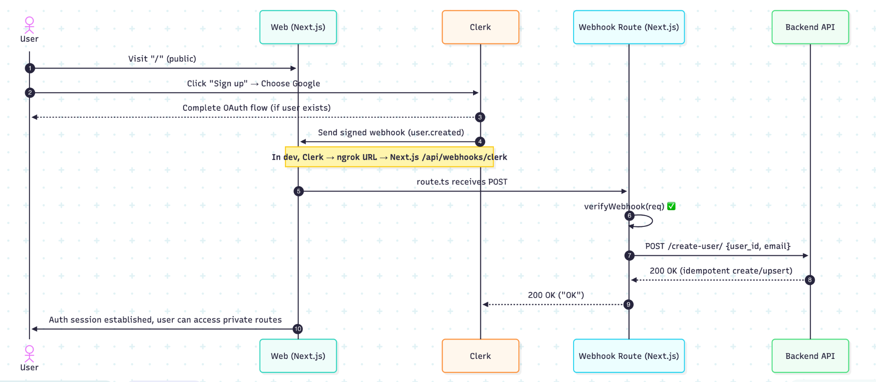

Slide 20
TESTING
TESTING
TESTING
TESTING
TESTING

Slide 21



TESTING
Our team has created a thorough testing design that efficiently checks every layer of the application:
Unit Testing
Integration Testing
End-to-End Testing
Pact Testing
Manual Testing
Some testing will be conducted using various tools such as:
GitHub Actions CI
Jest
Pytest

Slide 22
DEMO
DEMO
DEMO
DEMO
DEMO

Slide 23
QUESTIONS?
QUESTIONS?
QUESTIONS?
QUESTIONS?
QUESTIONS?

